Slide 1

Unlocking Insights with Time Series Analysis in Data Science
Kossi Akplaka
Population Health Analyst

Slide 2
What is time series analysis?
Time series analysis is a specific way of analyzing a sequence of data points collected over an interval of time. (every min, hour, day, etc.…)

Slide 3
Why time series analysis?
Many real-world applications
Industries | Time series analysis
Forecasting and Planning | sales, demand, and inventory levels
Financial Markets | stock price prediction, …
Energy Sector | forecast energy demand, …
Healthcare | monitoring patient vitals, …
Weather Forecasting | weather patterns and issue warnings
And More, etc.

Slide 4

Warehouse Demand Prediction Project
Goal: The goal was to accurately predict the demand for products in the warehouse.
Relevance: Accurate demand prediction can help us optimize inventory, reduce holding costs, and enhance customer satisfaction.

Slide 5

Data source
Data Source: You can find the data on Kaggle. https://www.kaggle.com/datasets/felixzhao/productdemandforecasting)

Slide 6

Challenges
Irregularly in the sampled dataset
Seasonality, trends, and residuals
Make Series Stationary
Models and accurate forecasting

Slide 7
Irregularly in the sampled datasets
Interpolate the time series data i.e., predict what those missing data by assuming that data samples behave monotonically at each interval. If this assumption doesn’t hold, it may lead to many artifacts or misleading results.
Resample the data can help reveal underlying patterns and trends, but we may lose some data

Slide 8
Seasonality, trends, and residuals
Seasonality: Recurring and predictable patterns or fluctuations in a time series that repeat at fixed intervals.
Trends: Increasing pattern over time.
Residuals: Random or unexplained fluctuations in a time series after accounting for seasonality and trend.

Slide 9
Why do we make time series stationary?
Stationarity means that the statistical properties of a time series do not change over time.
It does not require that individual data points have the same value but that the overall behavior remains constant.

Slide 10
SARIMA Model
S Seasonality
AR Auto-regression
I Integrity
MA Moving Average

Slide 11
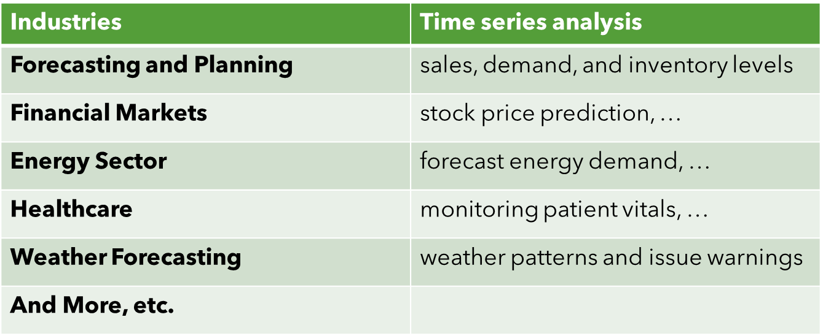
Real-World Impact

Slide 12
Thank You
Find this presentation on GitHub

